Slide 1
5. Network Configuration

Slide 2
Content
Network Configuration Wizard
Network setting and setting file
Name resolution
Confirmation of network setting
Notes:
In this lesson, we’ll learn how to provide the basic information for the computer to connect to the network. We need to recall that we have to provide at least 4 parameters: IP address, Netmask, routing information and DNS resolution information. Linux provide us several way to configure these parameter. We can use the network configuration wizard, configuring command or we can modify directly configuration files. To be able to o all the task correctly and do not interference between methods, we’ll learn how these tools change the active configuration, and what the configuration will be considered as a default configuration when the system start.

Slide 3
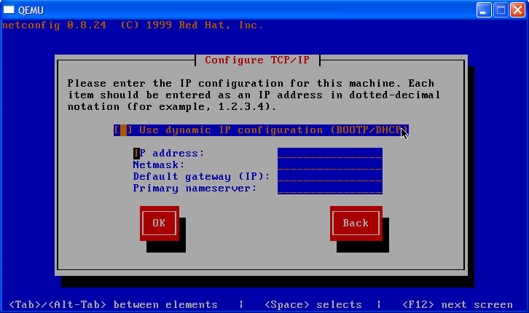
Network Configuration Wizard
Notes:
Configuration wizard is a program provide a interactive interface to enter parameters for network configuration. The program will accept user input, verifies it, write into configuration files and then update the current configuration. That means the program must be executed as root in order to modify the configuration files and to start and stop the networking services. There are many program for this purpose, with command line interface, with interactive interface, with graphical interface. Nowadays, Installation program includes a network configuration tools.In the figure bellows an example of such program is presented.

Slide 4
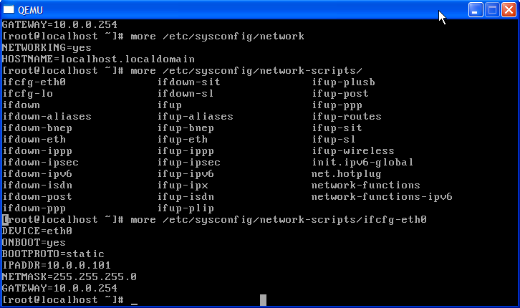
Network setting and setting file
Notes:
In this Linux distribution, network configuration are stored in /etc/sysconfig/network. The location of the file can varies in other distribution. The ‘/etc/sysconfig/network’ file is a file to establish common settings for the network interface such as the hostname and the default gateway. The main setting items for the ‘/etc/sysconfig/network’ file are as follows:
NETWORKING=yes|no: Set about whether to use the network.
NETMASK= subnet mask: Set the subnet mask allocated in the network interface.
NETWORK= network address: Set the network address allocated in the network interface.
ONBOOT= yes | no :Set by specifying whether to make the network interface effective when the system start-y -up. The specification of “yes” makes the network interface effective when the system start-up. The specification of “no” makes the network interface invalid.
TYPE=Ethernet : It is specification of the device type. ‘Ethernet’ is specified. Besides this, there are XDSL, etc.
HOSTNAME=hostname: Specify the hostname.
GATEWAY= IP address of default gateway :Set IP address of default gateway.
GATEWAYDEV= network interface :Set the network interface to be connected with GATEWAYDEV the default gateway.
FORWARD_IPV4=yes|no :Set by specifying whether you do the IP forwarding (forward of the IP packet).
For example, in the case of a computer to which multiple network interface cards are mounted, you can make a computer in which Linux is installed carry out the function as router, by specifying “yes” for this item.

Slide 5
Name resolution
Method | File
Host | /etc/hosts
Nis+ | /usr/lib/nis/nisclient –D
Nis | /etc/ypbind.conf
DNS | resolv.conf
Search Order | /etc/nsswitch
Notes:
The name resolution is to find out the IP address of a computer from the hostname given to a computer.
Networking using the TCP/IP protocol, the computer identifies itself to the other party of the communication using the IP address. However, because the IP address is merely four figures delimited by the period, it is difficult for us
to remember and is very cumbersome to use.In order to eliminate this inconvenience, it is desirable that we communicate using the hostname. However, TCP/IP protocol does not allow the computer to communicate by using the host name.
Thus, we need a system called DNS and a mechanism called 'name resolution', to enable us to find out the computer's IP address from its hostname given to a computer.
The information in the hosts file is shown in the table. Host is a old style of resolution, when all mapping are stored in a local file /etc/hosts. NUS provide also name resolution. If an item is listed in more than one systems, the priority order is defined in .etc.nsswitch.

Slide 6
Confirmation of network setting
Hostname
IPAddress
Routing table
Reachability
DNS
Notes:
In this course, routing table is simply default gateway. More complex routing can be done by command route.
To check the network setting, follows the steps bellow:
Check the hostname using hostname
Check if network is configured by using ifconfig
Check the reachability by using ping
Ping a hostname of an existing machine
Ping an IP an existing machine
Ping the DNS server
Ping the default GW

Slide 7
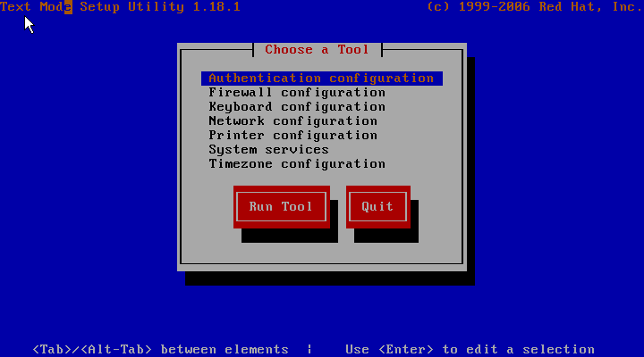
Change Network Setting
Setup tools

Slide 8
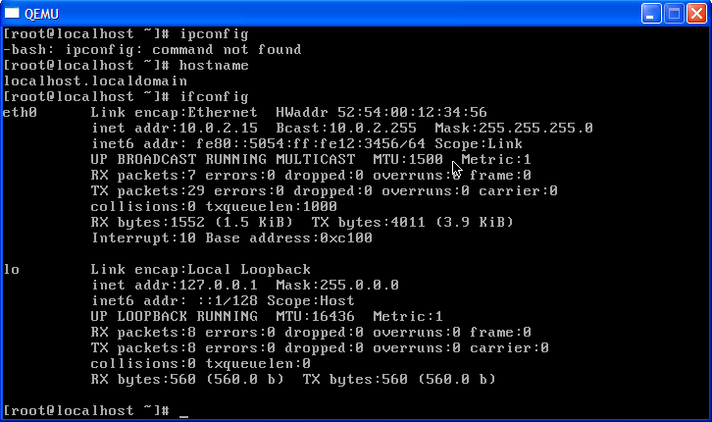
Verification-01

Slide 9
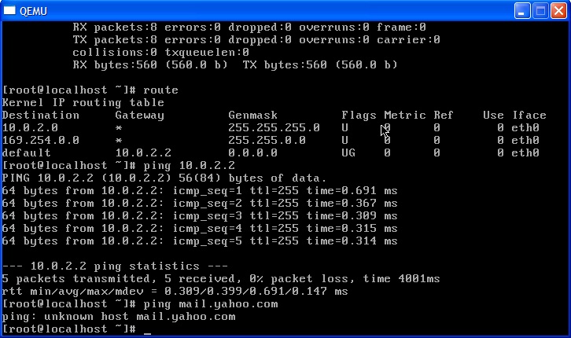
Verification-02

Slide 10
Summary
Network configuration parameters
Network configuration files
Network configuration tools

